Slide 1
Cover Ratio Maximization
Keming Li 11612126

Slide 2
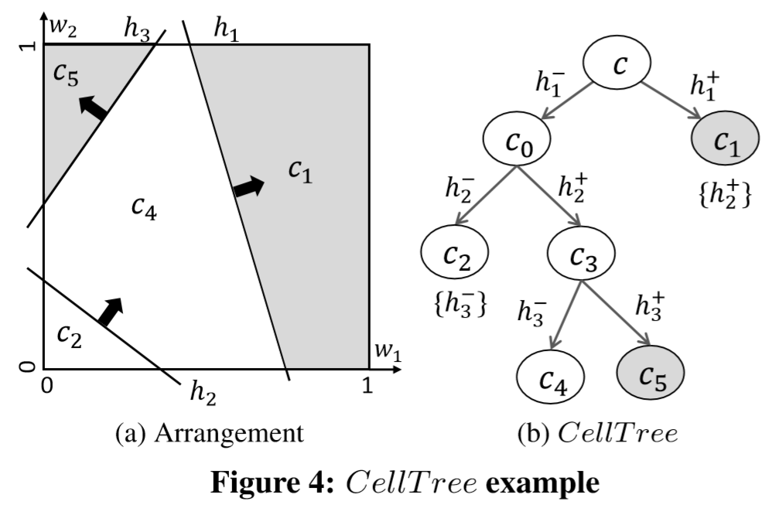
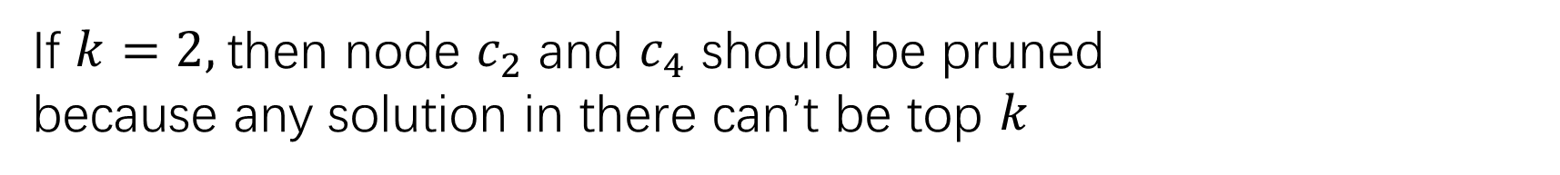
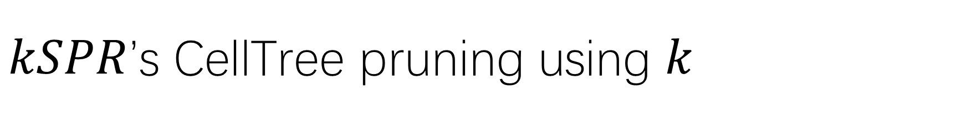
$kSPR$’s CellTree pruning using $k$
If $k=2,$then node $c_{2}$ and $c_{4}$ should be pruned
because any solution in there can’t be top $k$

Slide 3
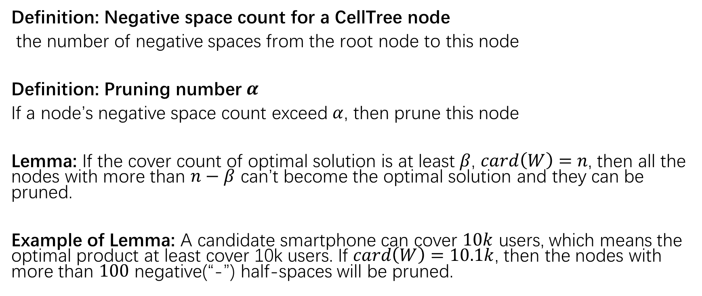
Pruning number
Definition: Negative space count for a CellTree node
the number of negative spaces from the root node to this node
Definition: Pruning number $α$
If a node’s negative space count exceed $α$, then prune this node
Lemma: If the cover count of optimal solution is at least $β$, $card\left(W\right)=n$, then all the nodes with more than $n−β$ can’t become the optimal solution and they can be pruned.
Example of Lemma: A candidate smartphone can cover $10k$ users, which means the optimal product at least cover 10k users. If $card\left(W\right)=10.1k$, then the nodes with more than $100$ negative(“-”) half-spaces will be pruned.

Slide 4
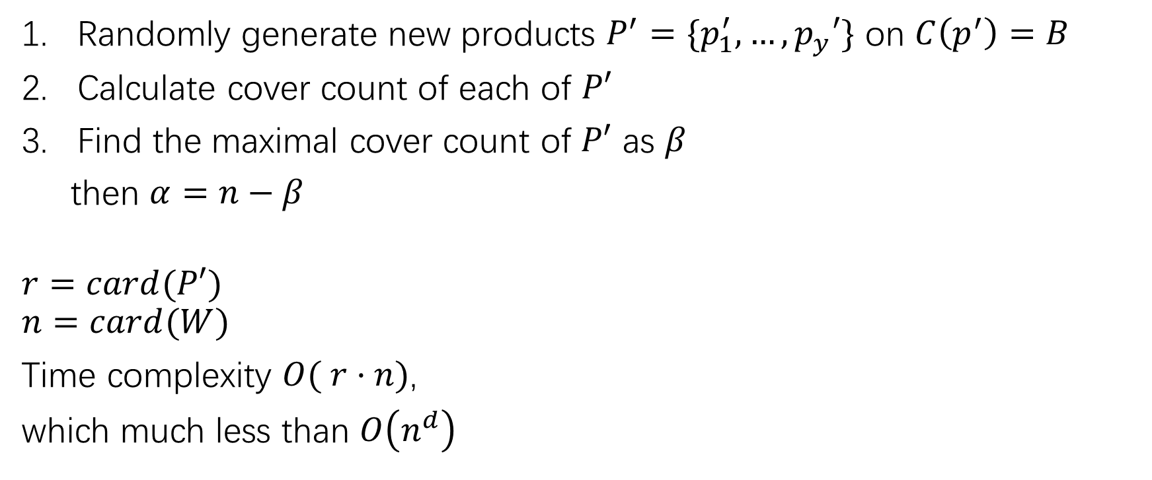
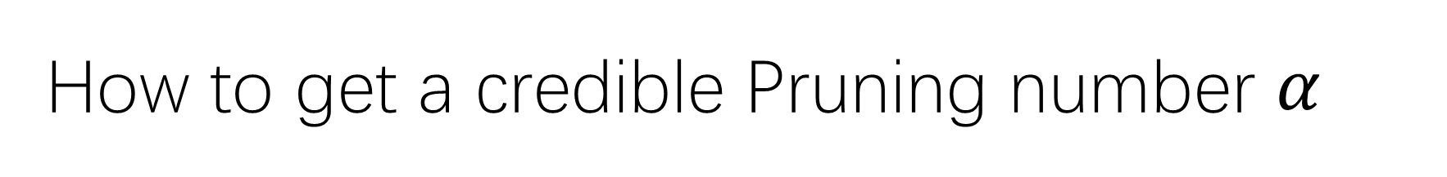
How to get a credible Pruning number $α$
Randomly generate new products $P^{′}=\{p_{1}^{′}, …,p_{y}′\}$ on $C\left(p^{′}\right)=B$
Calculate cover count of each of $P′$
Find the maximal cover count of $P′$ as $β$
then $α=n−β$
$$r=card(P′)$$
$$n=card(W)$$
Time complexity $O( r·n)$,
which much less than $O\left(n^{d}\right)$

Slide 5
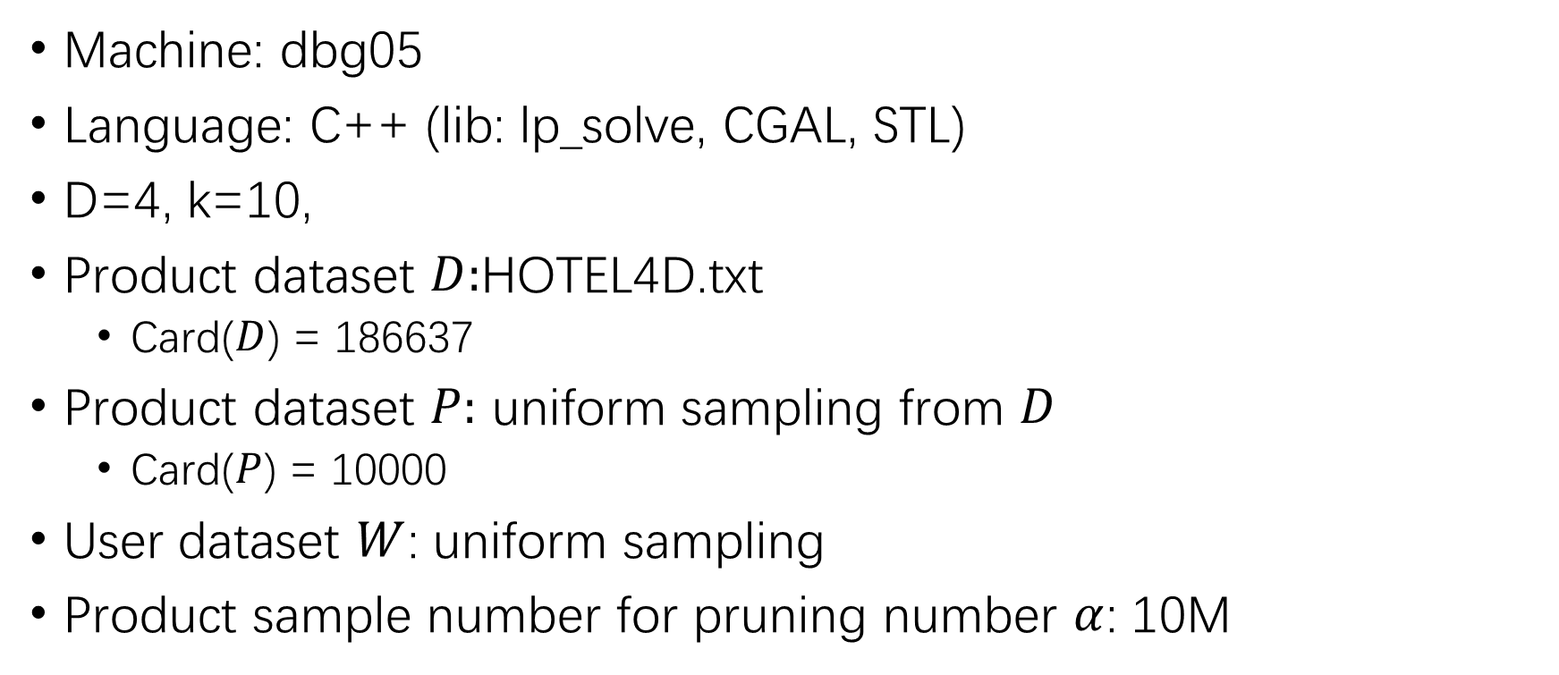
Default Experiment Setting
Machine: dbg05
Language: C++ (lib: lp_solve, CGAL, STL)
D=4, k=10,
Product dataset $D:$HOTEL4D.txt
Card($D$) = 186637
Product dataset $P:$ uniform sampling from $D$
Card($P$) = 10000
User dataset $W$: uniform sampling
Product sample number for pruning number $α$: 10M

Slide 6
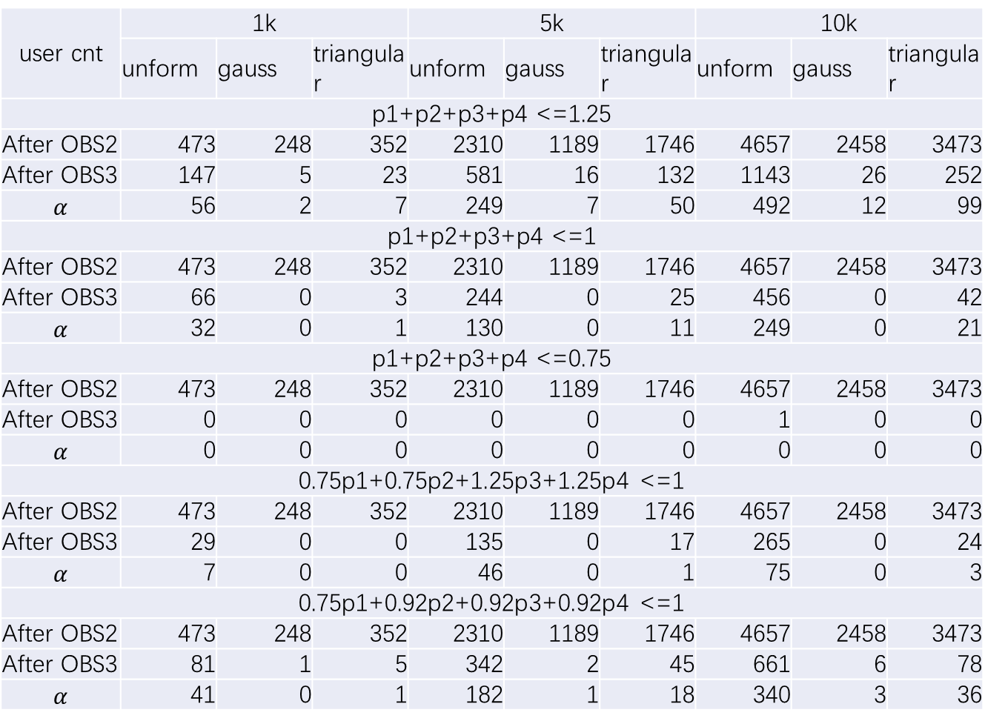
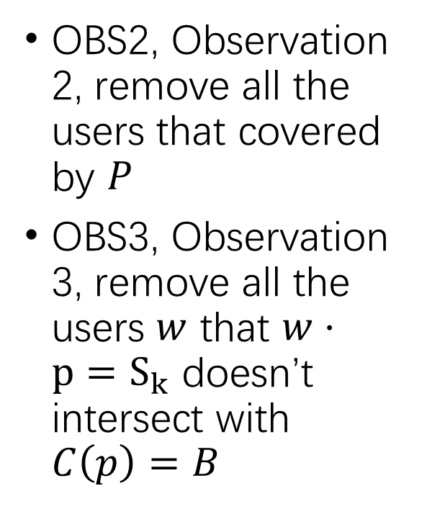
user cnt | 1k |  |  | 5k |  |  | 10k
 | unform | gauss | triangular | unform | gauss | triangular | unform | gauss | triangular
p1+p2+p3+p4 <=1.25
After OBS2 | 473 | 248 | 352 | 2310 | 1189 | 1746 | 4657 | 2458 | 3473
After OBS3 | 147 | 5 | 23 | 581 | 16 | 132 | 1143 | 26 | 252
 | 56 | 2 | 7 | 249 | 7 | 50 | 492 | 12 | 99
p1+p2+p3+p4 <=1
After OBS2 | 473 | 248 | 352 | 2310 | 1189 | 1746 | 4657 | 2458 | 3473
After OBS3 | 66 | 0 | 3 | 244 | 0 | 25 | 456 | 0 | 42
 | 32 | 0 | 1 | 130 | 0 | 11 | 249 | 0 | 21
p1+p2+p3+p4 <=0.75
After OBS2 | 473 | 248 | 352 | 2310 | 1189 | 1746 | 4657 | 2458 | 3473
After OBS3 | 0 | 0 | 0 | 0 | 0 | 0 | 1 | 0 | 0
 | 0 | 0 | 0 | 0 | 0 | 0 | 0 | 0 | 0
0.75p1+0.75p2+1.25p3+1.25p4 <=1
After OBS2 | 473 | 248 | 352 | 2310 | 1189 | 1746 | 4657 | 2458 | 3473
After OBS3 | 29 | 0 | 0 | 135 | 0 | 17 | 265 | 0 | 24
 | 7 | 0 | 0 | 46 | 0 | 1 | 75 | 0 | 3
0.75p1+0.92p2+0.92p3+0.92p4 <=1
After OBS2 | 473 | 248 | 352 | 2310 | 1189 | 1746 | 4657 | 2458 | 3473
After OBS3 | 81 | 1 | 5 | 342 | 2 | 45 | 661 | 6 | 78
 | 41 | 0 | 1 | 182 | 1 | 18 | 340 | 3 | 36
OBS2, Observation 2, remove all the users that covered by $P$
OBS3, Observation 3, remove all the users $w$ that $w·p=S_{k}$ doesn’t intersect with $C\left(p\right)=B$

Slide 7

user cnt | 1k |  |  | 5k |  |  | 10k
 | unform | gauss | triangular | unform | gauss | triangular | unform | gauss | triangular
p1+p2+p3+p4 <=1.25
After OBS2 | 473 | 248 | 352 | 2310 | 1189 | 1746 | 4657 | 2458 | 3473
After OBS3 | 147 | 5 | 23 | 581 | 16 | 132 | 1143 | 26 | 252
 | 56 | 2 | 7 | 249 | 7 | 50 | 492 | 12 | 99
p1+p2+p3+p4 <=1
After OBS2 | 473 | 248 | 352 | 2310 | 1189 | 1746 | 4657 | 2458 | 3473
After OBS3 | 66 | 0 | 3 | 244 | 0 | 25 | 456 | 0 | 42
 | 32 | 0 | 1 | 130 | 0 | 11 | 249 | 0 | 21
p1+p2+p3+p4 <=0.75
After OBS2 | 473 | 248 | 352 | 2310 | 1189 | 1746 | 4657 | 2458 | 3473
After OBS3 | 0 | 0 | 0 | 0 | 0 | 0 | 1 | 0 | 0
 | 0 | 0 | 0 | 0 | 0 | 0 | 0 | 0 | 0
0.75p1+0.75p2+1.25p3+1.25p4 <=1
After OBS2 | 473 | 248 | 352 | 2310 | 1189 | 1746 | 4657 | 2458 | 3473
After OBS3 | 29 | 0 | 0 | 135 | 0 | 17 | 265 | 0 | 24
 | 7 | 0 | 0 | 46 | 0 | 1 | 75 | 0 | 3
0.75p1+0.92p2+0.92p3+0.92p4 <=1
After OBS2 | 473 | 248 | 352 | 2310 | 1189 | 1746 | 4657 | 2458 | 3473
After OBS3 | 81 | 1 | 5 | 342 | 2 | 45 | 661 | 6 | 78
 | 41 | 0 | 1 | 182 | 1 | 18 | 340 | 3 | 36
For some range of users, $w·p=S_{k}$ not likely intersects with $C\left(p\right)=B$

Slide 8
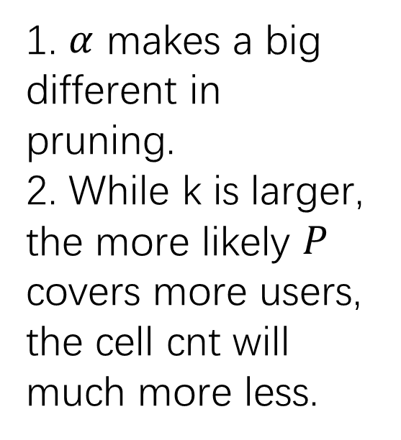
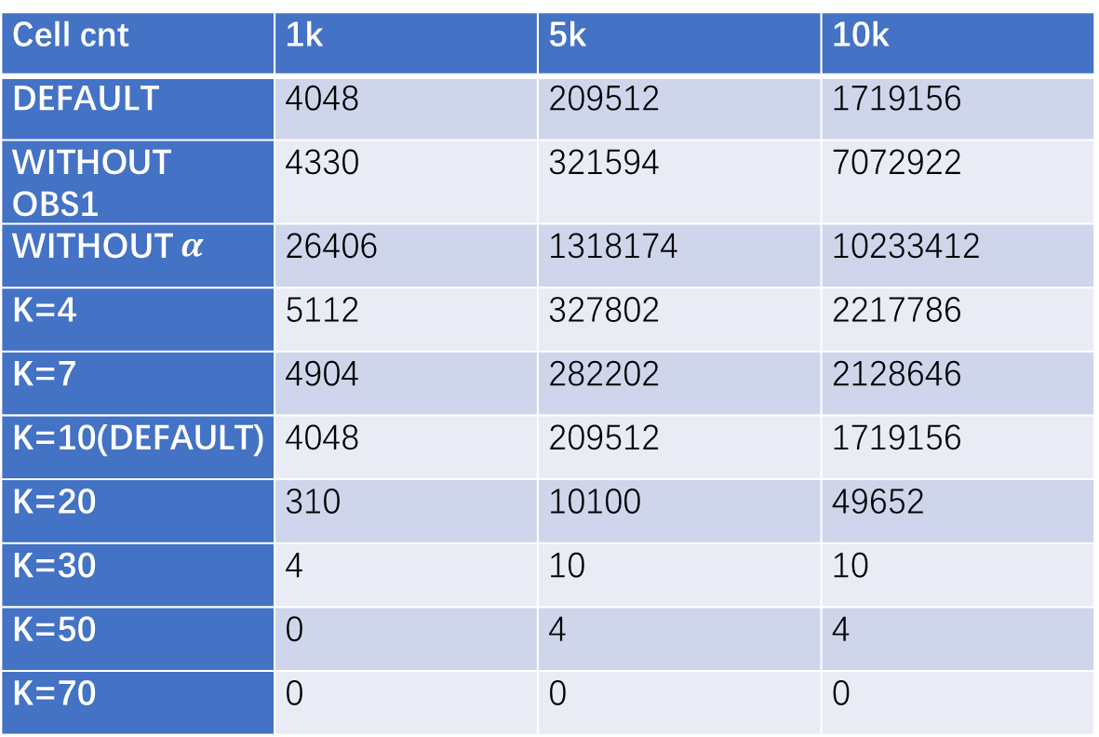

Cell cnt | 1k | 5k | 10k
DEFAULT | 4048 | 209512 | 1719156
WITHOUT OBS1 | 4330 | 321594 | 7072922
 | 26406 | 1318174 | 10233412
K=4 | 5112 | 327802 | 2217786
K=7 | 4904 | 282202 | 2128646
K=10(DEFAULT) | 4048 | 209512 | 1719156
K=20 | 310 | 10100 | 49652
K=30 | 4 | 10 | 10
K=50 | 0 | 4 | 4
K=70 | 0 | 0 | 0
1. $α$ makes a big different in pruning.
2. While k is larger, the more likely $P$ covers more users, the cell cnt will much more less.
OBS1: Observation 1, only consider $C\left(p\right)=B$
Without OBS1: consider $C\left(p\right)≤B$

Slide 10

Cell Tree time | 1k | 5k | 10k
OBS1 | 3.25 | 229.48 | 1918.4
WITHOUT OBS1 | 3.32 | 360.1 | 5759.59
WITHOUT prunk | 21.8 | 1528.71 | 12571.7
K=4 | 4.3 | 369.72 | 2583
K=7 | 3.94 | 307.17 | 2443.84
K=10(DEFAULT) | 3.25 | 229.48 | 1918.4
K=20 | 0.3 | 9.74 | 48.78
K=30 | 0 | 0.01 | 0.01
K=50 | 0 | 0 | 0
K=70 | 0 | 0 | 0
1. $α$ makes a big different in pruning.
2. While k is larger, the more likely $P$ covers more users, the cell cnt will much more less.
OBS1: Observation 1, only consider $C\left(p\right)=B$
With out OBS1: consider $C\left(p\right)≤B$

